Slide 1
SQL Basics (Create, INSERT, SELECT)
Afreenzehra sayed

Slide 2
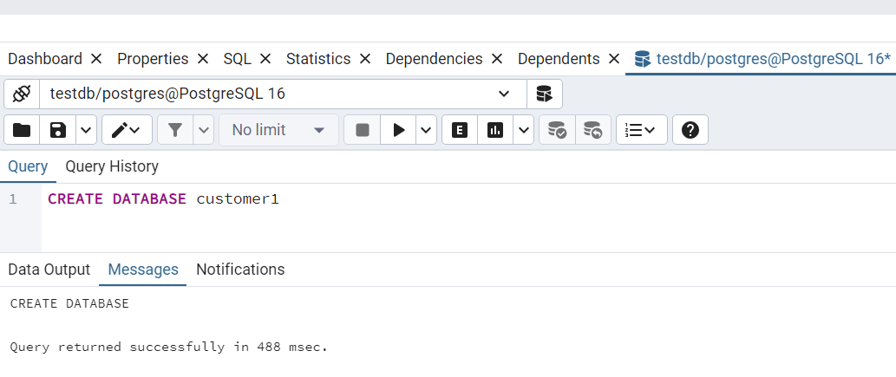
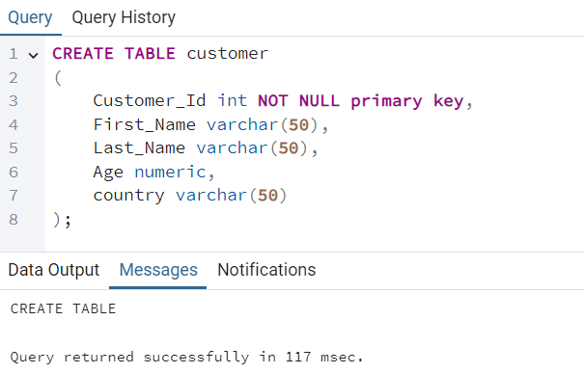
create database and table inside database

Slide 3
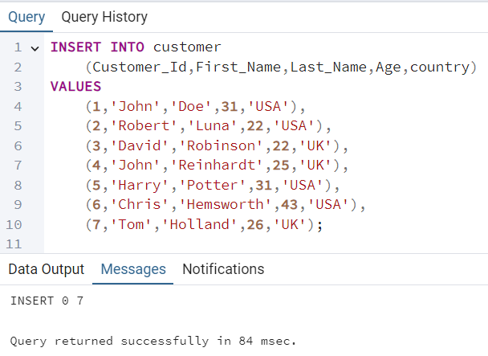
INSERT VALUES inside the table

Slide 4
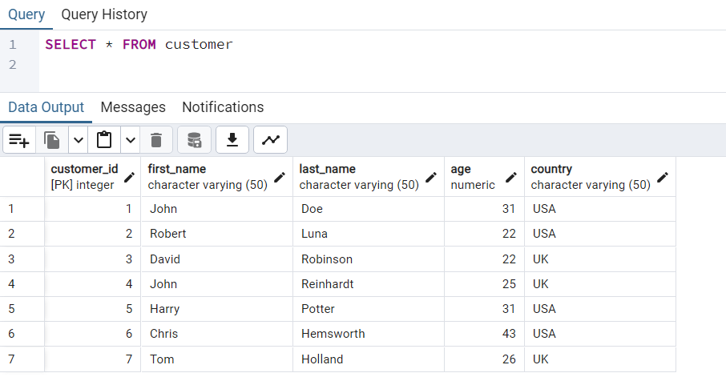
SELect statement
This query displays all the values of each column from the customer table. Here * represents ‘all’

Slide 5
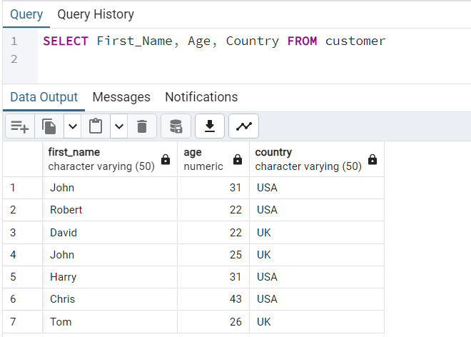
SELect statement
This query displays the values of a particular column from the customer table.

Slide 6
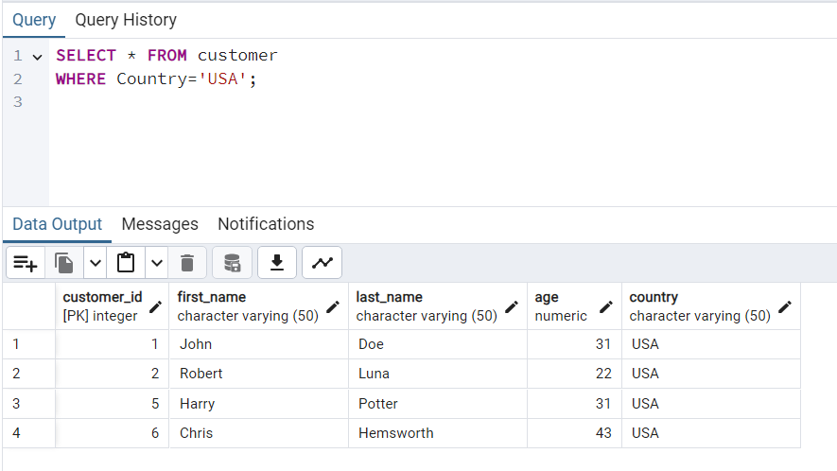
SELect statement with where clause
The Select statement with where clause returns only those rows which satisfies a specific condition mentioned in the query.

Slide 7
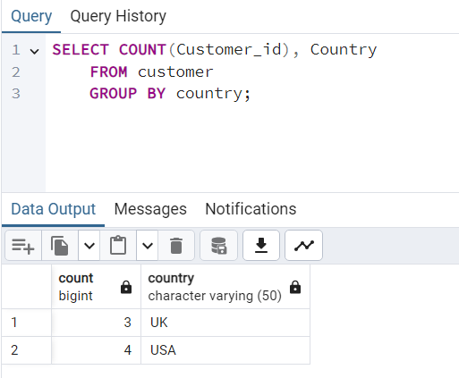
SELect statement with GROUP BY clause
The Group by clause shows the common data from the customer table

Slide 8
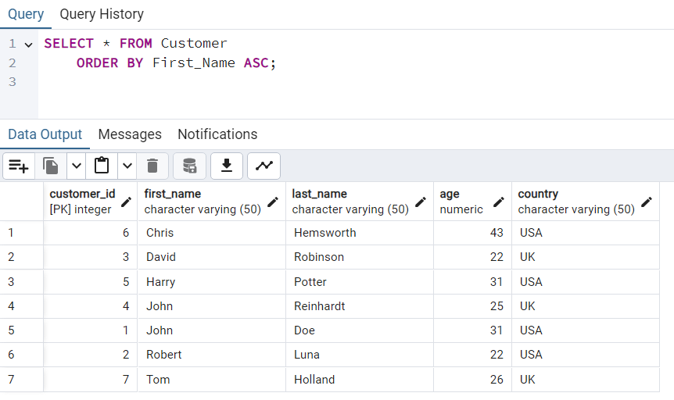
SELect statement with ORDER BY clause
The following query sorts the name alphabetically in the ascending order. The name can also be sorted in the descending order using ‘DESC’

Slide 9
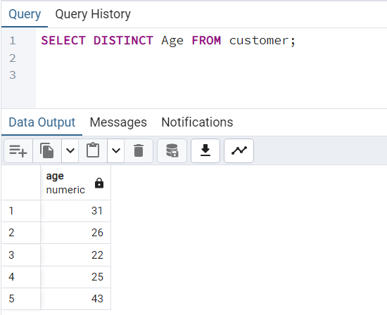
SELect DISTINCT statement
Select DISTINCT shows different(distinct) values of a column containing many duplicates

Slide 10
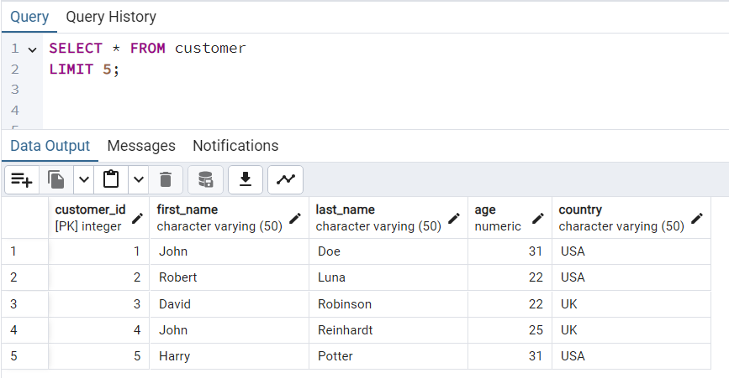
SELect statement with LIMIT
The LIMIT clause is used to limit the maximum number of records to return.

Slide 11
HELPFUL? REPOST

